Slide 1
IIT Bombay
Page 1
Course Code : EE 611
Department: Electrical Engineering
Instructor Name: Jayanta Mukherjee
Email: jayanta@ee.iitb.ac.in
Lecture 12
EE 611 Lecture 12 Jayanta Mukherjee

Slide 2
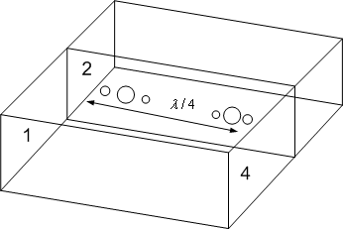
IIT Bombay
Page 2
Directional Couplers
EE 611 Lecture 10 Jayanta Mukherjee
EE 611 Lecture 12 Jayanta Mukherjee

Slide 3
IIT Bombay
Page 3
Types of Couplers
EE 611 Lecture 10 Jayanta Mukherjee
EE 611 Lecture 12 Jayanta Mukherjee

Slide 4
IIT Bombay
Page 4
3 dB Hybrid Couplers
90º | 180º
Coupled Line | Magic Tee
Branch Line | Rat Race
Lange Coupler | Tapered Line coupler
EE 611 Lecture 10 Jayanta Mukherjee
EE 611 Lecture 12 Jayanta Mukherjee

Slide 5
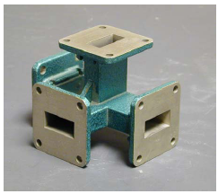
IIT Bombay
Page 5
Magic Tee
EE 611 Lecture 10 Jayanta Mukherjee
EE 611 Lecture 12 Jayanta Mukherjee

Slide 6
IIT Bombay
Page 6
Branch Line Hybrid Coupler
EE 611 Lecture 10 Jayanta Mukherjee
EE 611 Lecture 12 Jayanta Mukherjee

Slide 7
IIT Bombay
Page 7
Even and Odd Mode Analysis
EE 611 Lecture 10 Jayanta Mukherjee
EE 611 Lecture 12 Jayanta Mukherjee
Notes:
7

Slide 8
IIT Bombay
Page 8
Even Odd Analysis
EE 611 Lecture 10 Jayanta Mukherjee
EE 611 Lecture 12 Jayanta Mukherjee
Notes:
8

Slide 9
IIT Bombay
Page 9
Even Odd Analysis
EE 611 Lecture 10 Jayanta Mukherjee
EE 611 Lecture 12 Jayanta Mukherjee
Notes:
9

Slide 10
IIT Bombay
Page 10
ABCD Matrices
EE 611 Lecture 10 Jayanta Mukherjee
EE 611 Lecture 12 Jayanta Mukherjee
Notes:
10

Slide 11
IIT Bombay
Page 11
ABCD Matrices
EE 611 Lecture 10 Jayanta Mukherjee
EE 611 Lecture 12 Jayanta Mukherjee
Notes:
11

Slide 12
IIT Bombay
Page 12
Coupling and Insertion Loss
EE 611 Lecture 10 Jayanta Mukherjee
EE 611 Lecture 12 Jayanta Mukherjee
Notes:
12

Slide 13
IIT Bombay
Page 13
General Branch Line Coupler
EE 611 Lecture 10 Jayanta Mukherjee
EE 611 Lecture 12 Jayanta Mukherjee
Notes:
13

Slide 14
IIT Bombay
Page 14
Branch Line Hybrid S matrix
EE 611 Lecture 10 Jayanta Mukherjee
EE 611 Lecture 12 Jayanta Mukherjee
Notes:
14

Slide 15
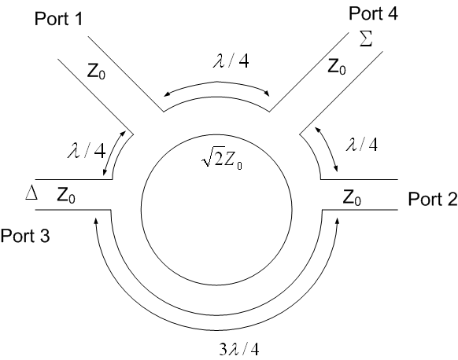
IIT Bombay
Page 15
Rat Race 180º Hybrid
EE 611 Lecture 10 Jayanta Mukherjee
EE 611 Lecture 12 Jayanta Mukherjee

Slide 16
IIT Bombay
Page 16
Rat Race 180º Hybrid
EE 611 Lecture 10 Jayanta Mukherjee
EE 611 Lecture 12 Jayanta Mukherjee

Slide 17
IIT Bombay
Page 17
Rat Race 180º Hybrid
EE 611 Lecture 10 Jayanta Mukherjee
EE 611 Lecture 12 Jayanta Mukherjee

Slide 18
IIT Bombay
Page 18
Coupled lines
EE 611 Lecture 10 Jayanta Mukherjee
EE 611 Lecture 12 Jayanta Mukherjee

Slide 19
IIT Bombay
Page 19
Coupled lines
EE 611 Lecture 10 Jayanta Mukherjee
EE 611 Lecture 12 Jayanta Mukherjee

Slide 20
IIT Bombay
Page 20
Even Mode in Coupled lines
EE 611 Lecture 10 Jayanta Mukherjee
EE 611 Lecture 12 Jayanta Mukherjee

Slide 21
IIT Bombay
Page 21
Odd Mode in Coupled lines
EE 611 Lecture 10 Jayanta Mukherjee
EE 611 Lecture 12 Jayanta Mukherjee

